Slide 1

WELCOME
to IPVCITY

Slide 2
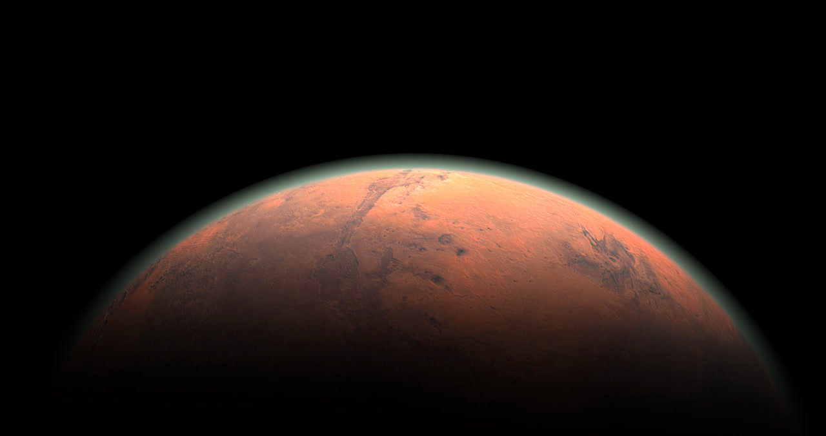
This is a futuristic, smart city situated on Mars, with the primary function of establishing a decent environment for human beings on the red planet.

Slide 3
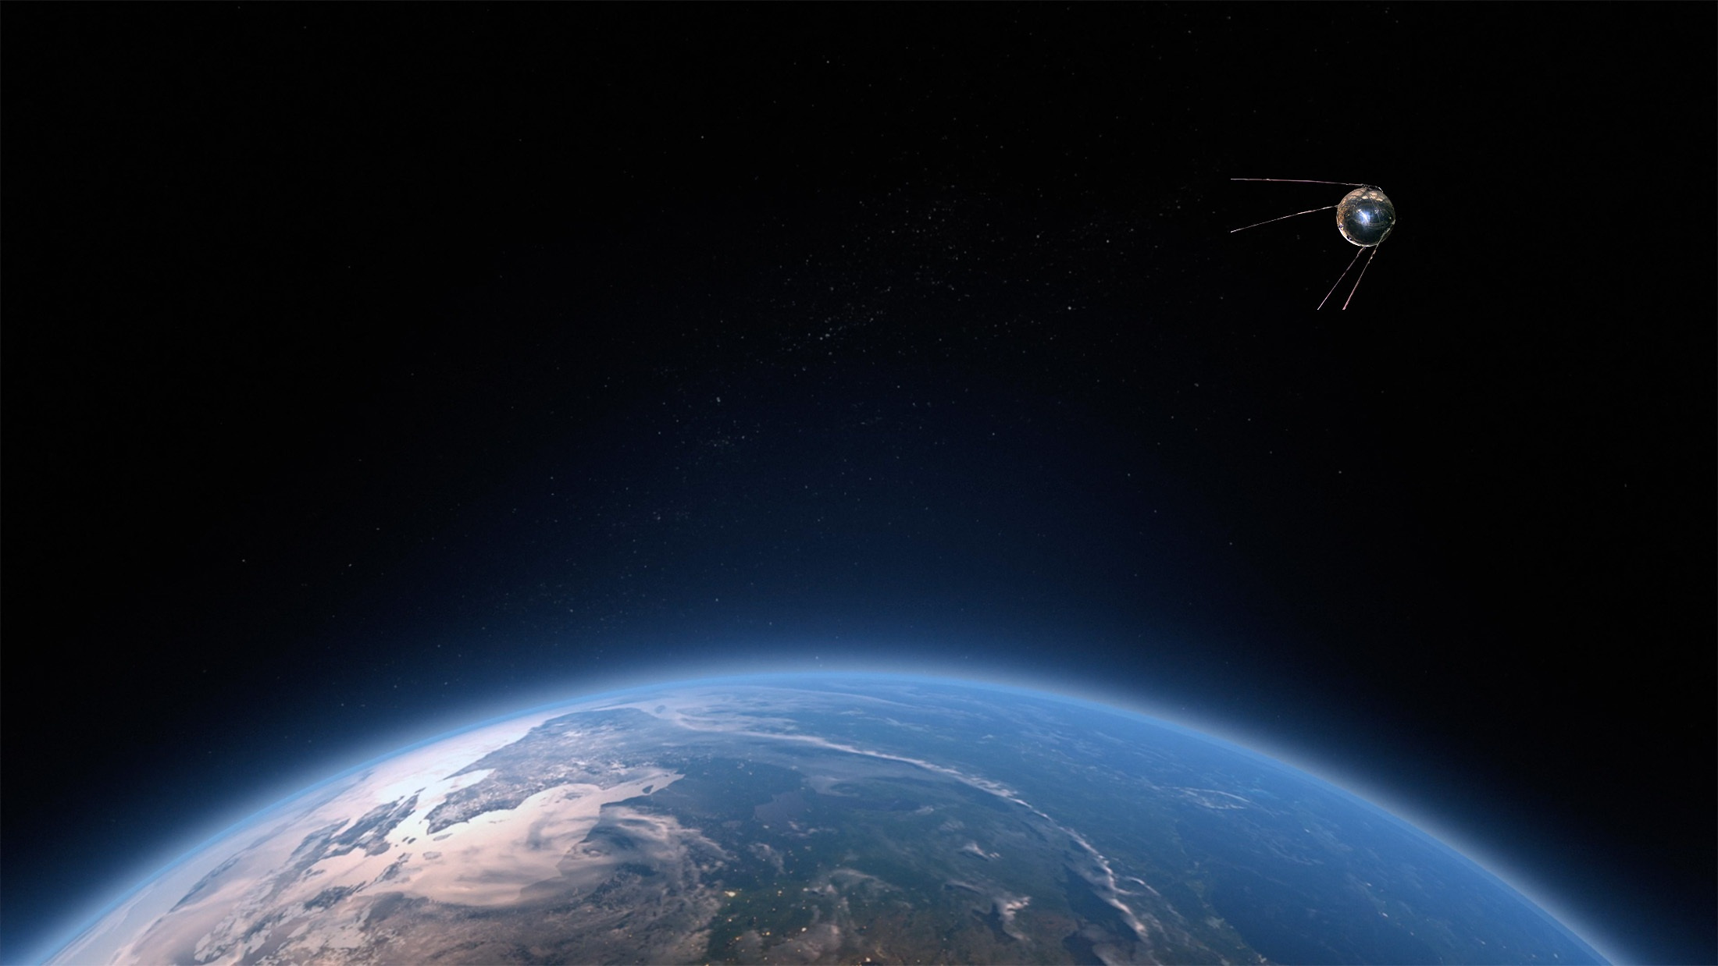
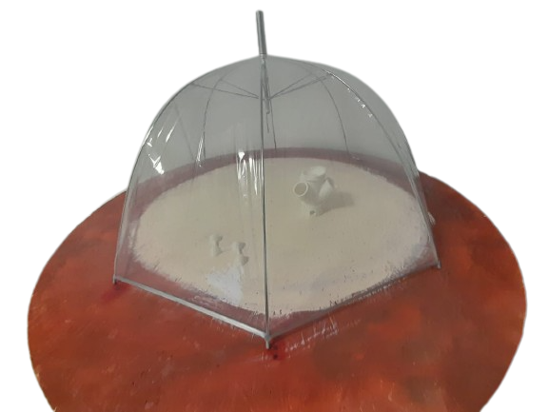

The challenges we faced while constructing the project included:
Building the circuits
and writing the code
Measuring of the Martian terrain.
Adjusting the codes and the circuits
Designing the city itself
In the beginning
In the end

Slide 4
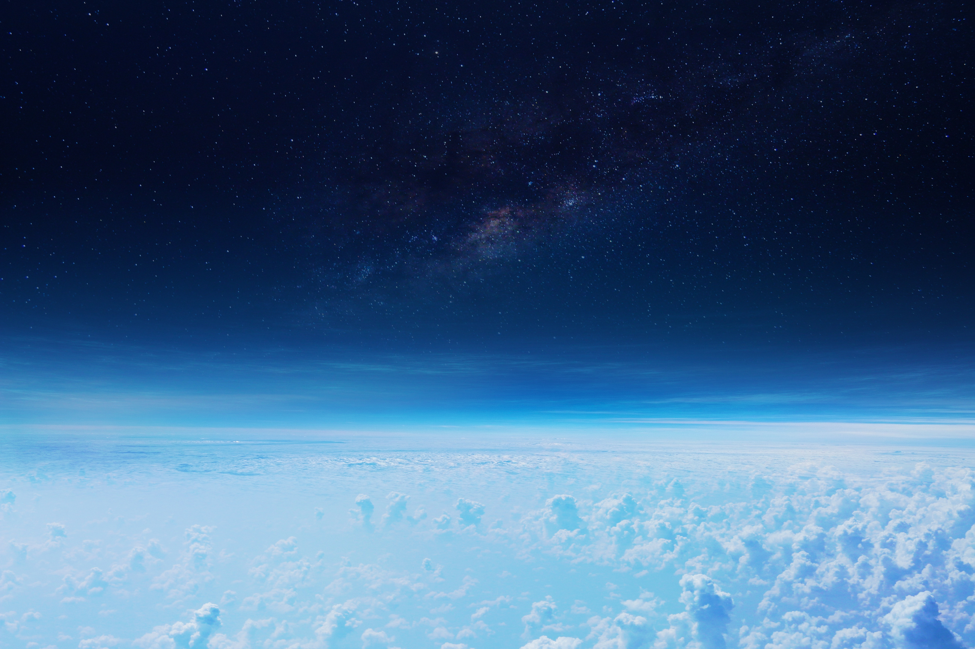
We programmed the Microbits using advanced understanding of Python and we utilized all sorts of components in the process.
the hardest challenge that we faced was
in the future we could make the city be able to fly and replace it on Venus to colonize it too

Slide 5
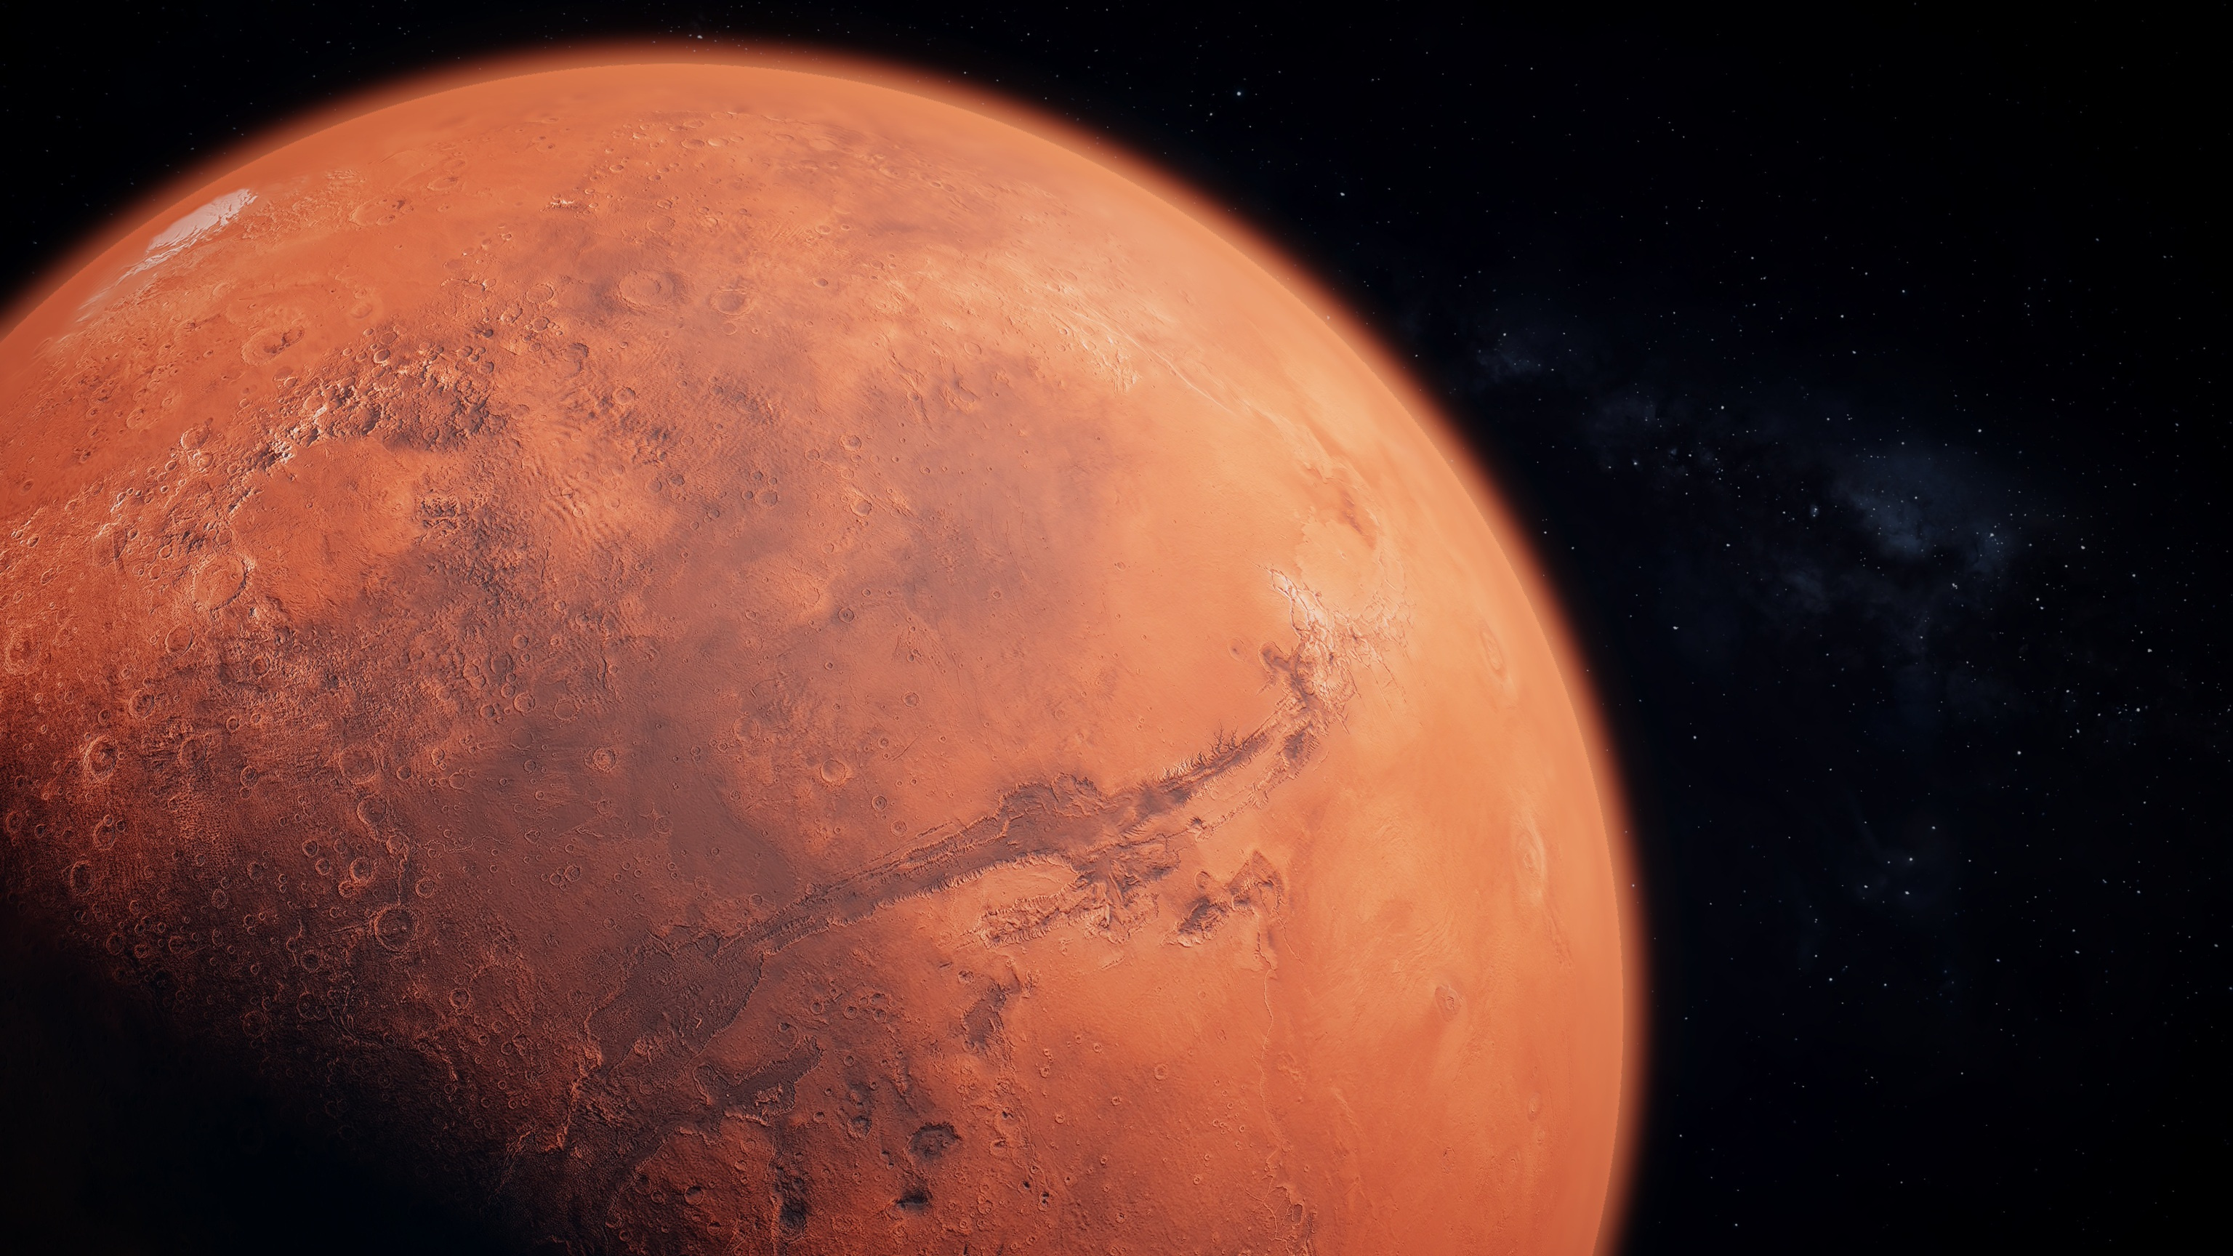
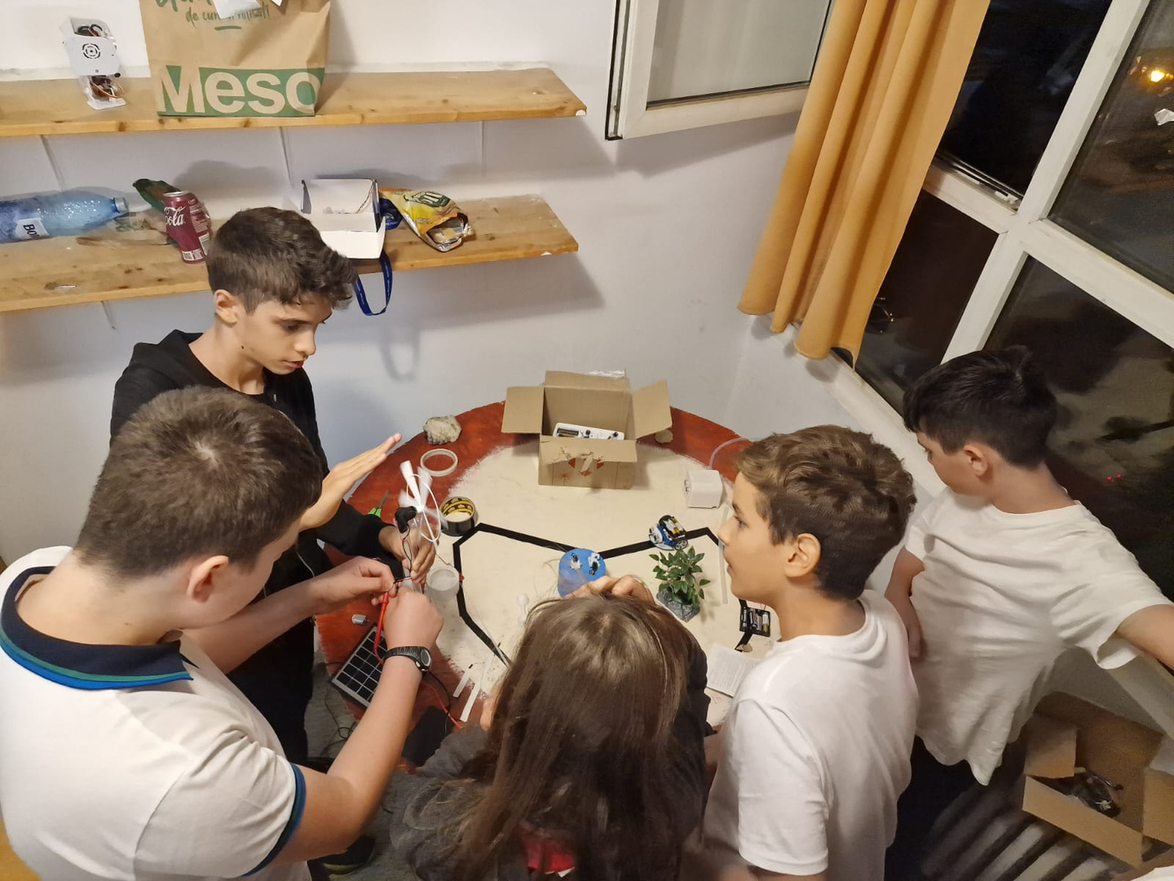

We all worked together as a team, collaborating and supporting each other.

Slide 6


We encountered several challenges during the construction of the hydroelectric dam, which proved to be the most technically demanding project. However, we successfully completed it. Its primary purpose is to generate electricity for the city, similar to how solar panels and wind turbines contribute to our power supply.

